Slide 1
Eater Game
2D mobile game
Krish Moradiya
19SE02CE047

Slide 2
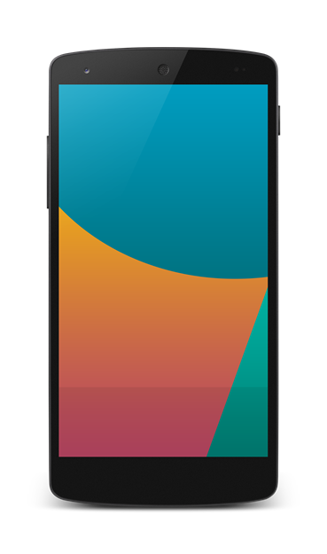
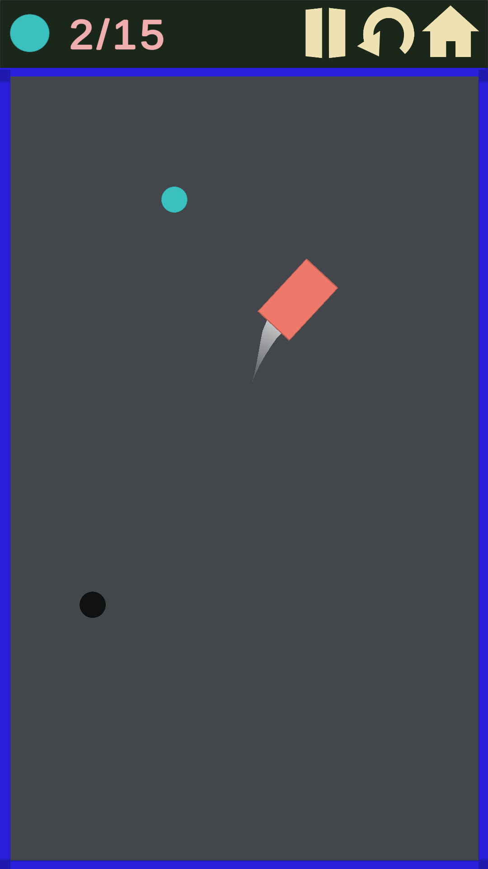


Introduction
This is a android game which is named as EATER GAME.
EATER GAME is creating in unity game engine. Unity is a platform which is useful for making a games. For creating this game I have use C# coding language. using this coding I have created an algorithm such that snake is going to eat the food & update and increase the point for user.
In this game there are many objects, graphics and sound effects are used for creating such a creative application and attracting more and more users.
In this game there were 3 characters named as:
1. snake(user) 2. food 3. poison
In which food and poison will generate on random place. user can get more & more point by eating food. unfortunately If user(snake) eat poison it will destroy and game will end.

Slide 3
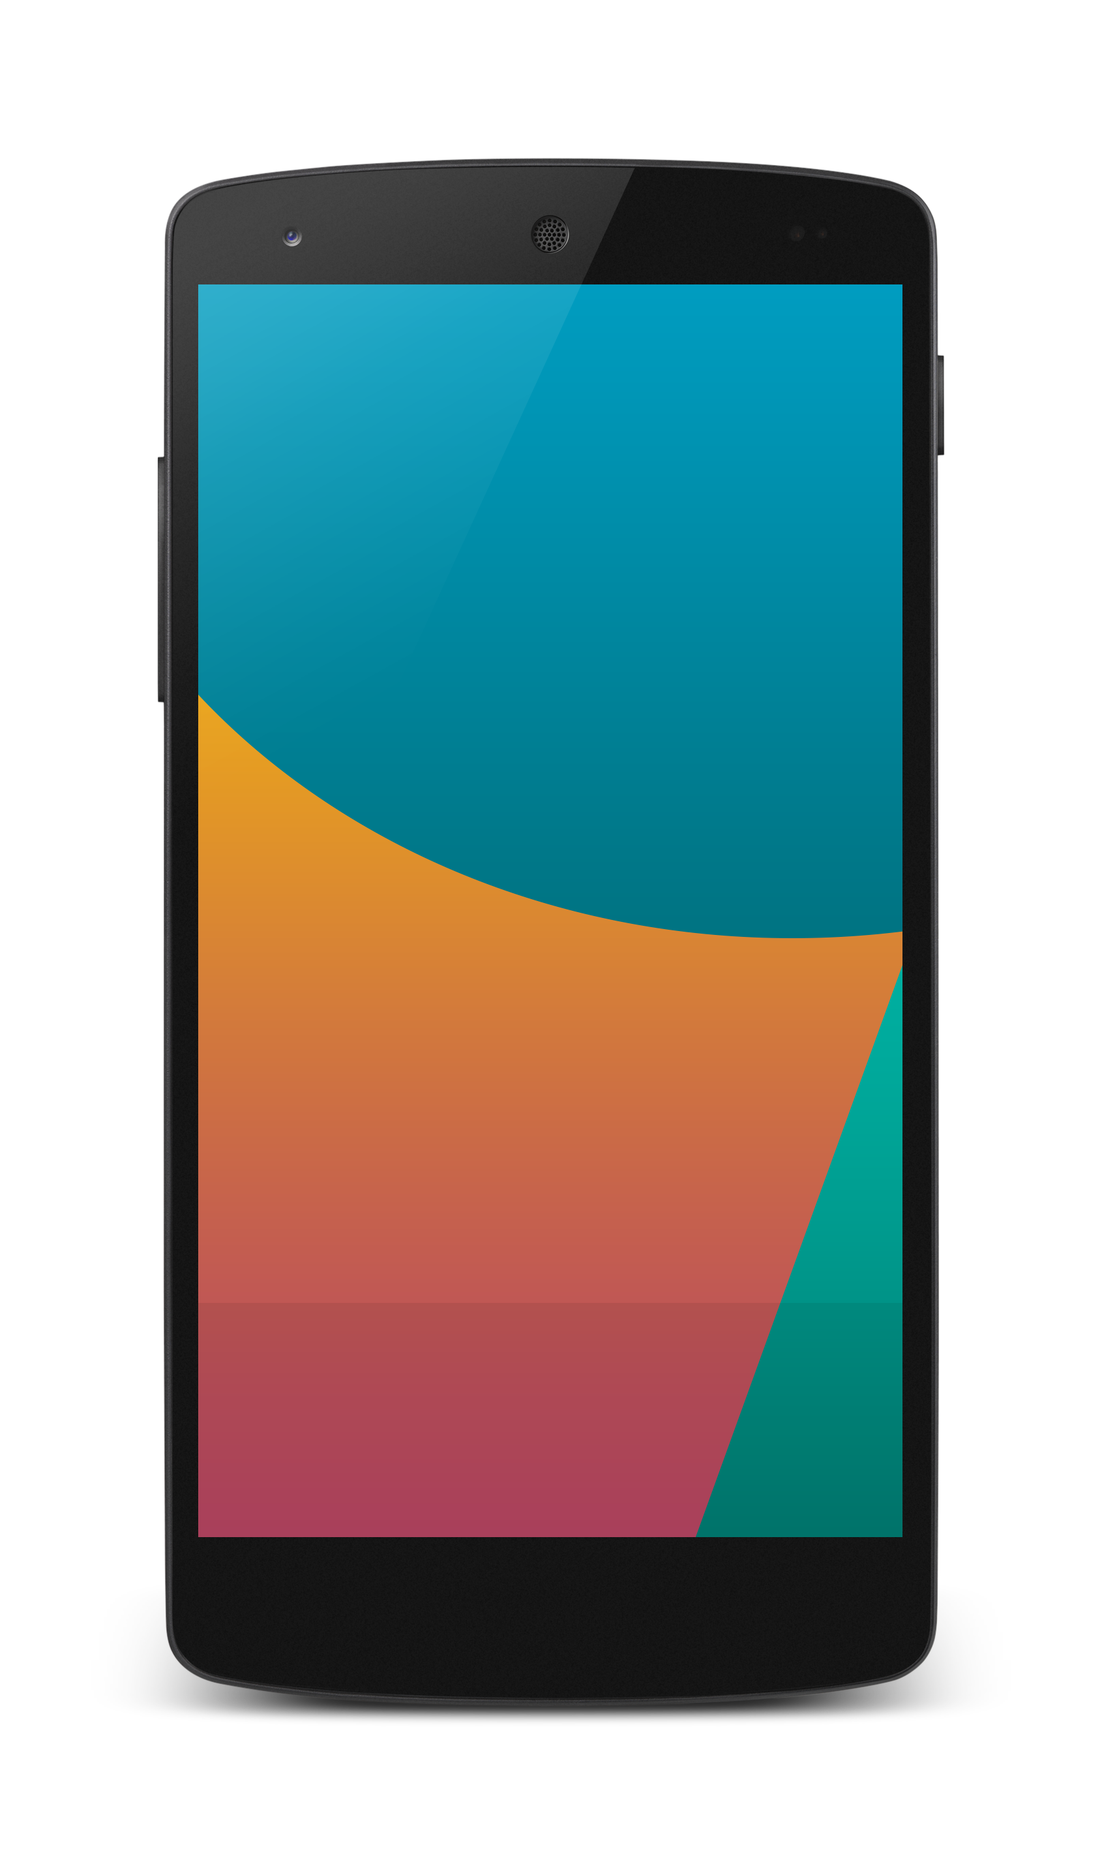
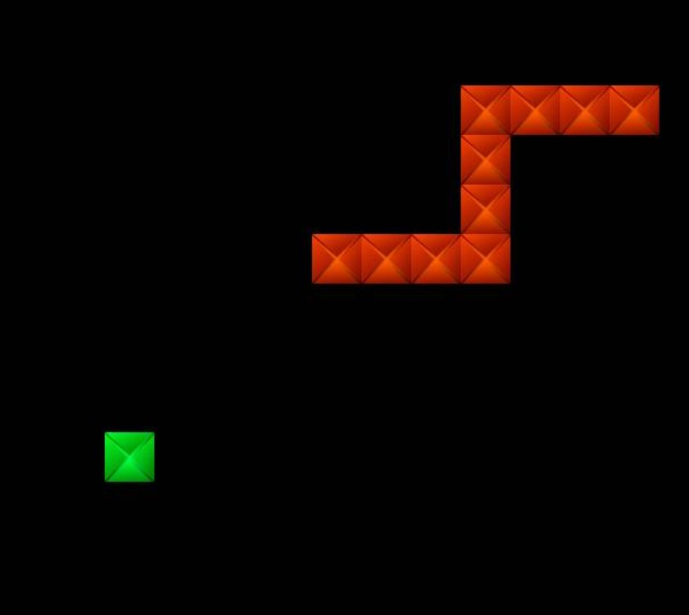
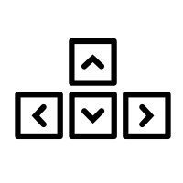
Old snake games vs Eater game
In other snake game , snake is move one pixel at a time.
User click on one of Arrow key to change the path of the snake (Move four direction).
In Eater game , snake is move freely.
I have set a Algorithm in which when we will click -x direction to move Anticlock wise and x direction to move clock wise with respect to center(0) and z-axis of mobile (Move all direction).
+y
-x 0 +x
This is the main feature of Eater game.
To Move Anticlockwise
To Move Clock wise

Slide 4
levels
In this game there are 3 level. In all level snake take 15 food to win. This food in random position.
Easy level
Hard level
MEDIUM LEVEL
In this level snake take 15 food to win. There is no given any poison and boundary so that users have Opportunity to get more and more points and there snake never destroy.
In this level snake take 15 food to win. There is no given any poison but boundary is given to user so that users have to take note that they should not touch this wall. otherwise snake will destroy.
In this level snake take 15 food to win. given all poison and boundary so that users have to play with full concentration and safely. Even if snake will eat poison or touch the wall they will out and snake will destroy and game will end.

Slide 5
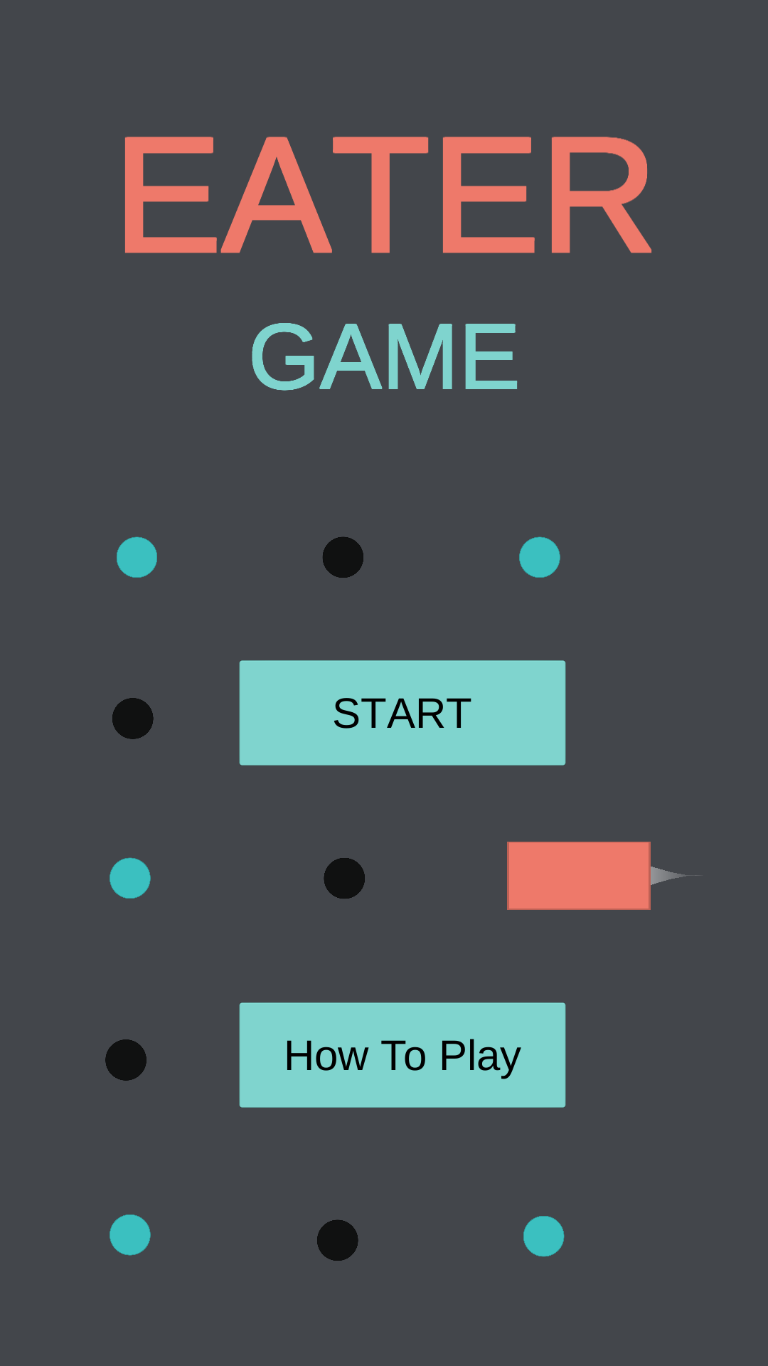
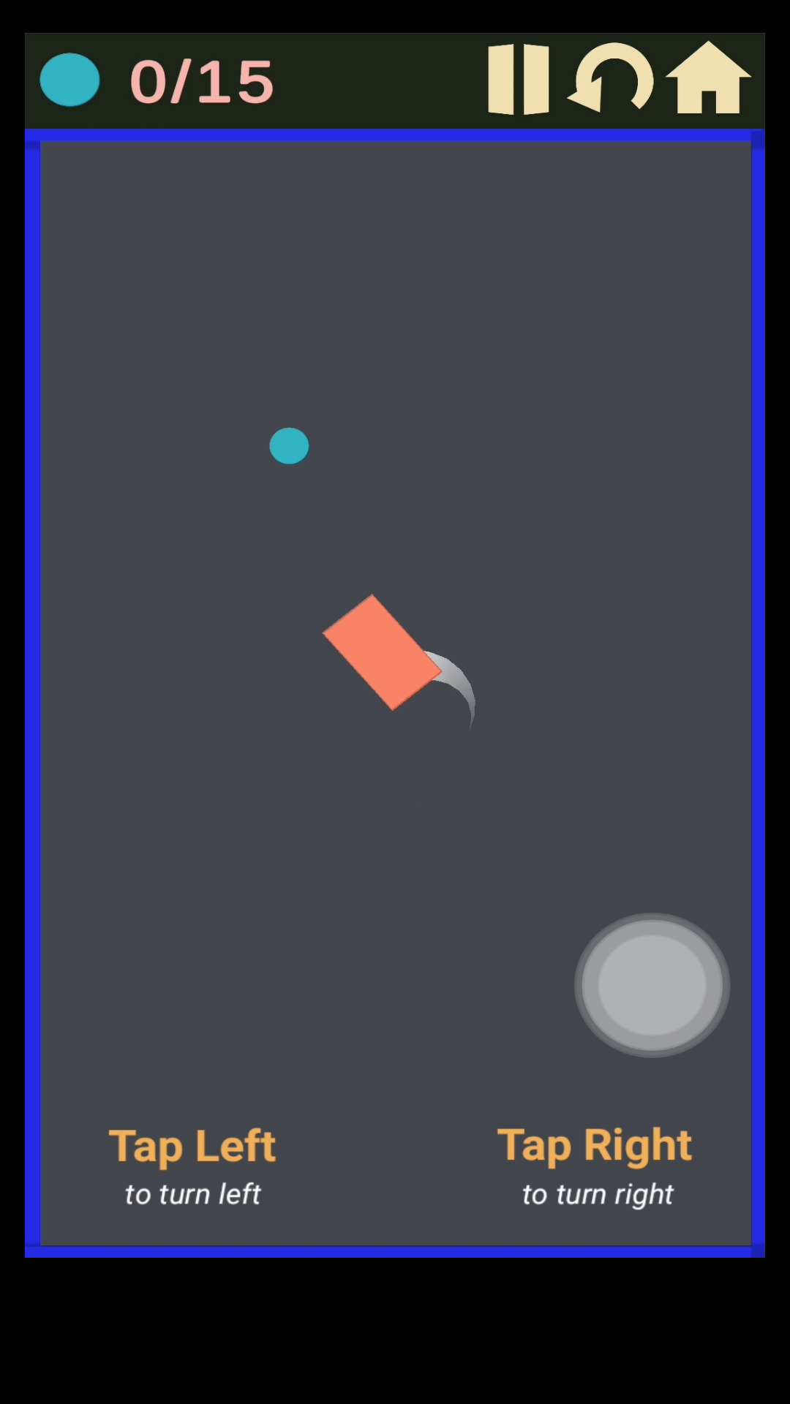
How to play
In this game their is a button named "How to play" Which is guide us to play this game.
When user click this button there is one video to help the user.

Slide 6
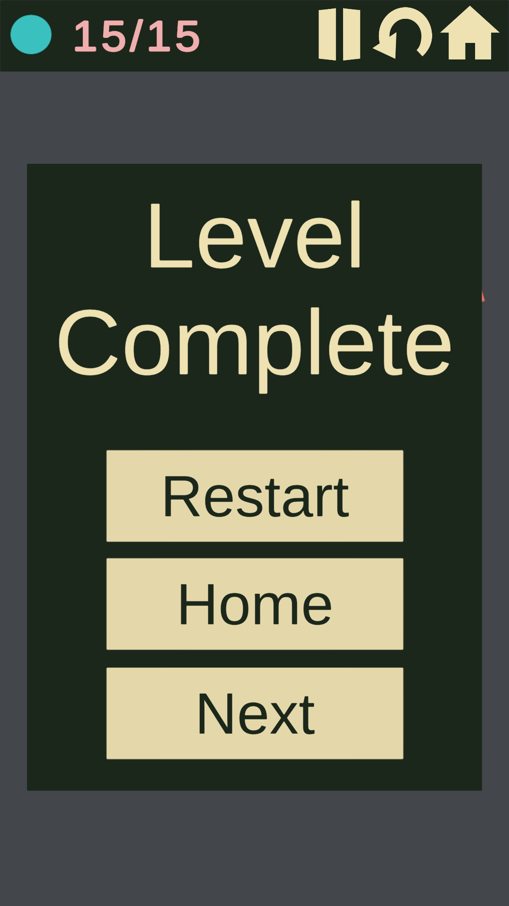
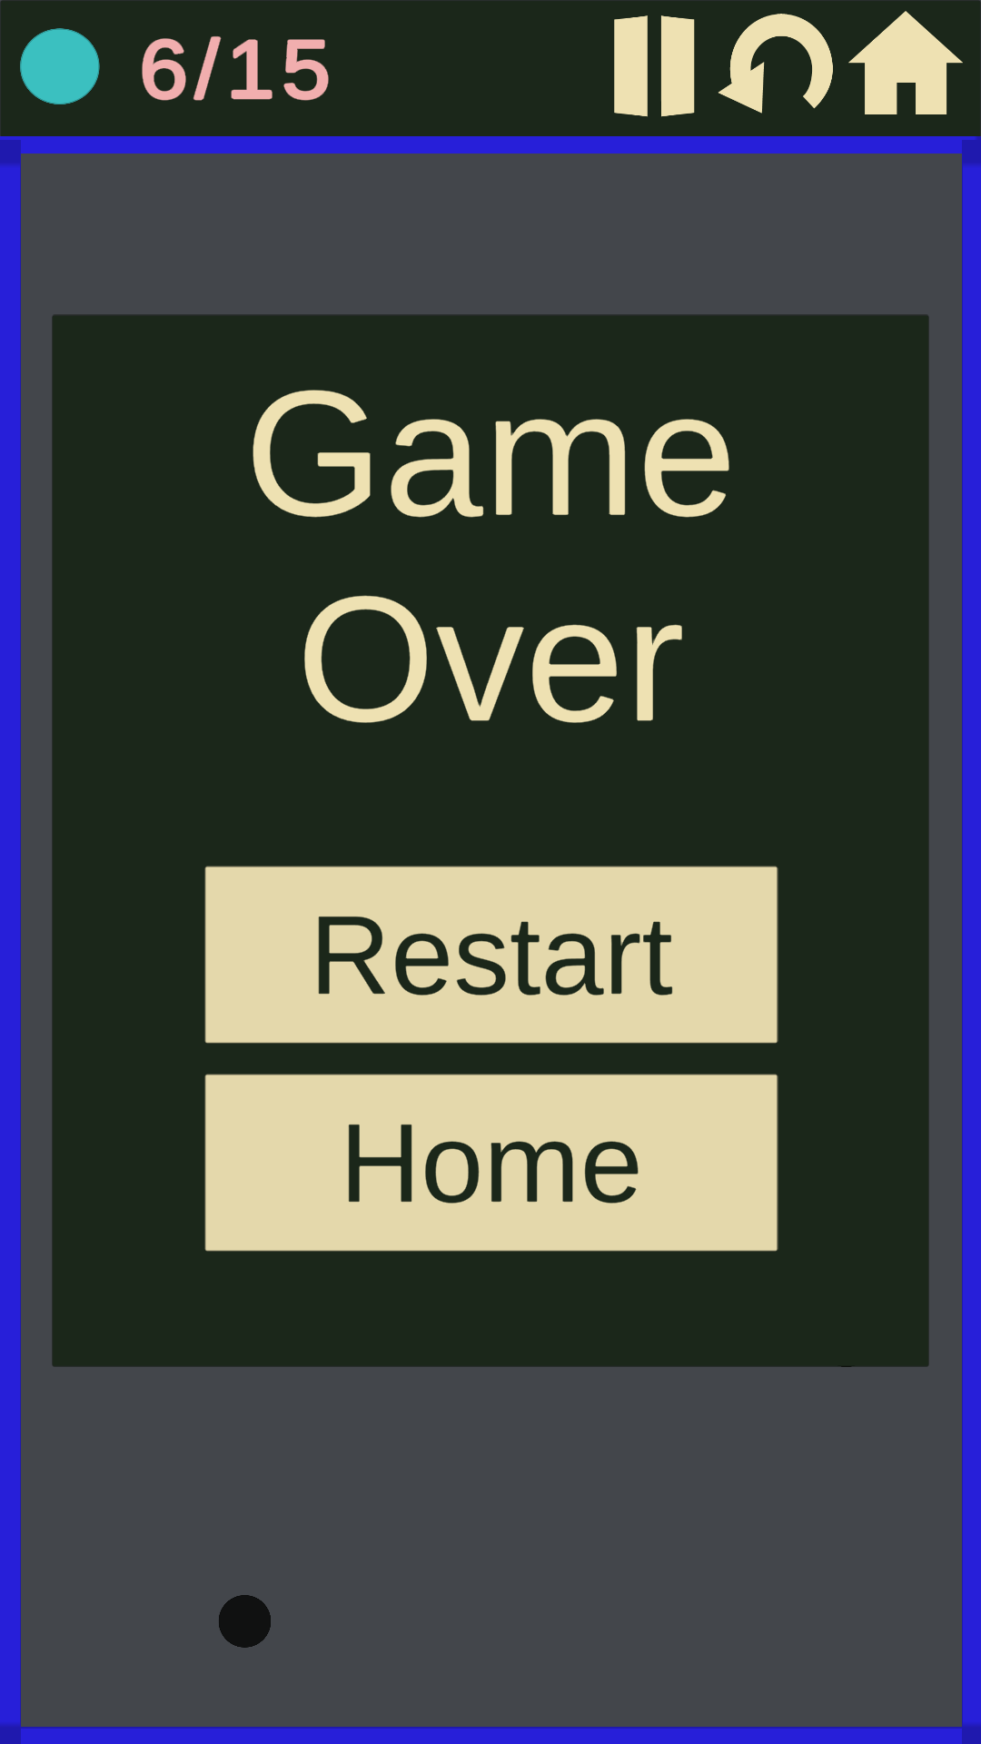
UI design
In this game I give UI design and button functionality to users get best gaming experience.
Buttons:
Restart
Home
Next
Replay
Push/Play

Slide 7
Overview of future intense
My intense for creating this game is I want to be a successful & good game developer.
I will make some change in app like creating more attractive graphics and Also put some more level according to difficulties.
Which is be more enthusiastic for user.

Slide 8

The end
Thank you for watching my presentation of information about EATER GAME

